Slide 1


WELCOME
Welcome to the Presentation
Macroeconomics
Course Code: BUS 3509
MD Abdullah Al Noman
Lecturer , DBA, BAIUST
Bangladesh Army International University of Science and Technology

Slide 2
CONSTITUENTS OF THE PRESENTATION
Consumption and Types of Consumption
Consumption Function and key components
Consumption Function in the short run
Consumption Function in the long run
Average Propensity to Consume (APC)
Marginal Propensity to Consume (MPC)
Linear Consumption Function
Non-linear Consumption Function

Slide 3
Consumption
In economics, consumption refers to the use of goods and services by households. Consumption is the process of satisfying human wants. So, The portion of income spent on goods and services to satisfy current needs and desires is called Consumption.
In economics, the equation Income = Consumption + Saving is a fundamental identity that describes how households allocate their disposable income.
Income= Consumption + Saving
The total earnings received by households, typically in the form of wages, salaries, profits, rents, and interest is called income.
The portion of income spent by households on goods and services to satisfy current needs and desires is called consumption.
The portion of income not spent on consumption, set aside for future use is called savings.

Slide 4
Types of Consumption
Autonomous Consumption:
This is the minimum level of consumption that occurs even when income is zero. It reflects spending on basic needs that households cannot avoid, such as food and shelter.
Induced Consumption:
This portion of consumption changes in response to changes in disposable income. It is represented by the marginal propensity to consume (MPC), which measures how much of additional income is spent on consumption.

Slide 5
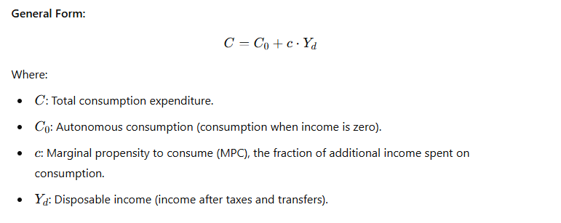
Consumption Function and key components
As the demand for a good depends upon its price, similarly consumption of a community depends on the level of income. In other words, consumption is a function of income. The consumption function relates the amount of consumption to the level of income. So, the consumption function is the whole schedule which describes the amounts of consumption at various levels of income.
Consumption function should be carefully distinguished from the amount of consumption. By consumption function is meant the whole schedule which shows consumption at various levels of income, whereas amount of consumption means the amount consumed at a specific level of income.

Slide 6
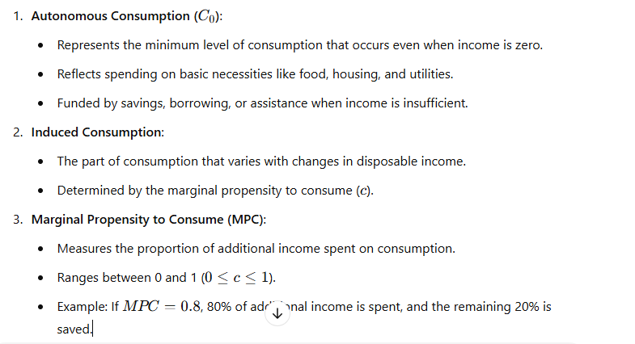
Consumption Function and key components
The consumption function is an economic concept that describes the relationship between a household's consumption expenditure and its disposable income.

Slide 7
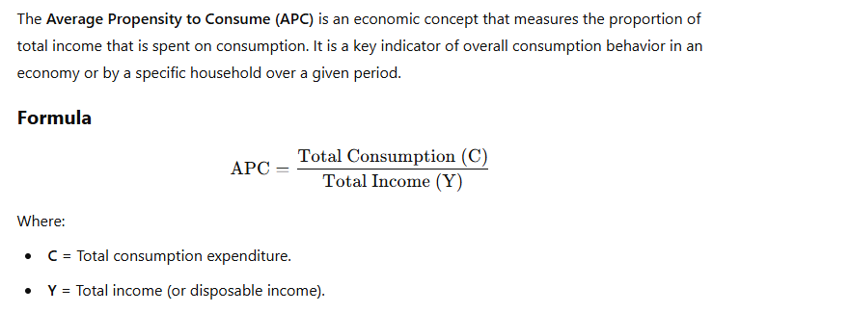
Average Propensity to Consume (APC)

Slide 8
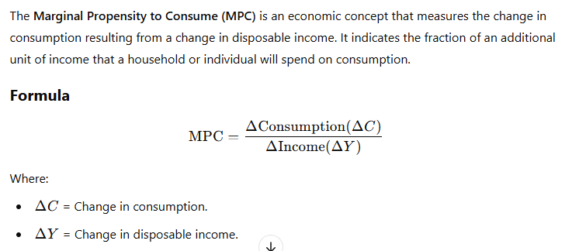
Marginal Propensity to Consume (MPC)

Slide 9
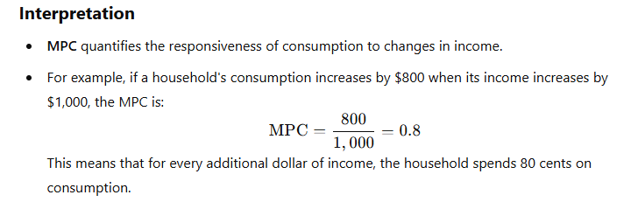
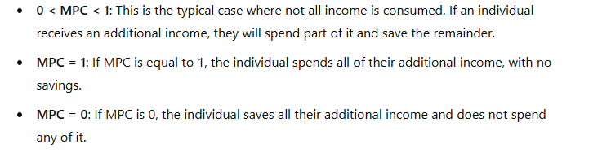
Marginal Propensity to Consume (MPC)

Slide 10
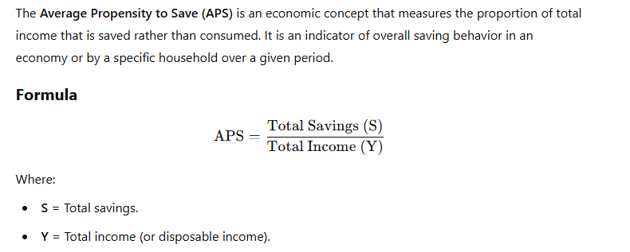
Average Propensity to Save (APS)
For example, if a household has an income of $50,000 and saves $10,000, the APS would be: 10,000 / 50,000 = 0.2. This means 20% of the household's income is saved, while 80% is spent on consumption.

Slide 11
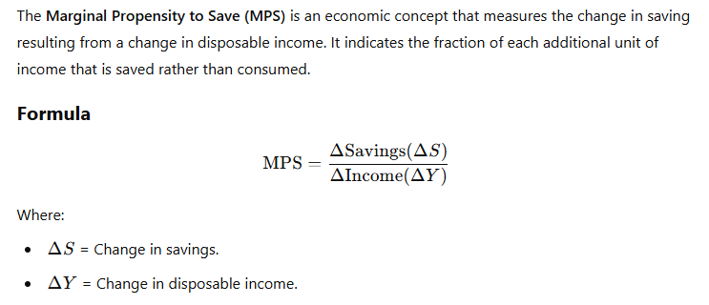
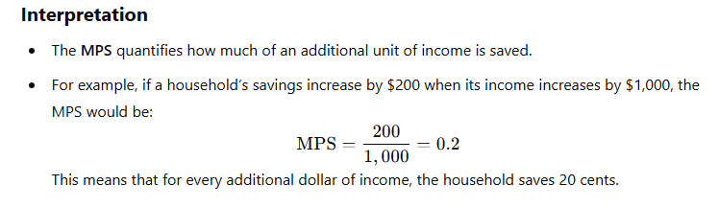
Marginal Propensity to Save (MPS)

Slide 12

Derivation of Saving function from consumption function
Let us derive an important relationship between average propensity to consume and average propensity to save. Restating below the relation that income is either consumed or saved:
C + S = Y
Dividing both sides by disposable income Y we have
Here, C / Y is average propensity to consume and
S / Y is average propensity to save,
APC + APS = 1
Or, APS = 1 – APC
This means, for example, that if a society consumes 75 per cent of its disposable income, that is, APC = 0.75, then it will save 25 per cent of its disposable income or its average propensity to save (APS) will be 0.25 (1 – 0.75 = 0.25).

Slide 13
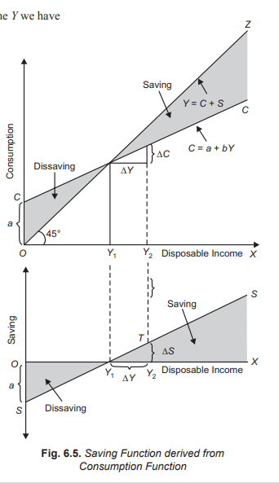
Derivation of Saving function from consumption function

Slide 14
Derivation of Saving function from consumption function
In Fig, we have drawn the saving function curve SS in the panel at the bottom. The saving function curve SS shows the gap between consumption curve CC and the income curve OZ in the upper panel of Fig. It will be seen that up to income level OY1, consumption exceeds income, that is, there is dissaving. Beyond income level OY1, there is positive saving. It is worth mentioning that as average propensity to consume (APC) falls with the increase in income in the upper panel, average propensity to save rises as income increases. Thus in Fig, with the increase in income not only the absolute amount of saving increases, the average propensity to save also increases.

Slide 15
Factors / determinants of influence the consumption function
Changes in the General Price Level : Real Balance Effect: When the general price level increases or, in other words, when inflation occurs, the consumption function shifts downward. This is because the rise in the general price level, real value (that is, purchasing power) of people’s money balances and financial assets with fixed monetary values declines. This causes a downward shift in the consumption function. This is called real balance effect. Similarly, when the general price level falls, real value of money balances and financial assets increases. This will induce people to consume relatively more out of their current income. This will cause an upward shift in the consumption function.
Fiscal Policy: Fiscal policy of the Government, especially taxation policy affects the propensity to consume of the country. By levying excise duties, sales tax, the Government can cut down the consumption and thereby increase savings of the community. Likewise, when the Government reduces taxes, consumption of the people increases and this raises the propensity to consume.
Rate of Interest: Rate of interest also affects the propensity to consume and save. It is generally believed that higher rate of interest induces the people to save more and this results in reducing their propensity to consume.

Slide 16
Factors / determinants of influence the consumption function
4. Stock of Wealth: The stock of wealth owned by the households in the economy is also an important factor that determines propensity to consume. In wealth we include not only real assets such as land, houses, automobiles but also financial assets such as cash balances, saving and fixed deposits with banks, stocks and bonds possessed by households. The greater the amount of wealth accumulated by households in the economy, the greater is generally the propensity to consume.
5. Monetary Policy and Credit Conditions: The availability of easy credit causes an increase in consumption and shifts the consumption function upward.
6. Change in Expectations: Changes in the expectations of the people also influence the propensity to consume. When people expect that prices to go up in the near future, then they will try to spend more on goods so as to meet the needs of the immediate future. This raises the consumption function in the current period. On the other hand, when people expect the prices to fall, they reduce their current consumption so that they should spend more when the prices actually fall.

Slide 17
Mathematical problems on consumption function
1.Given as consumption function C=50 + 0.5Y. Show that,
  Find out the saving function.
  APS+APC= 1
  MPS+MPC=1
  Find out the breakeven point.

Slide 18
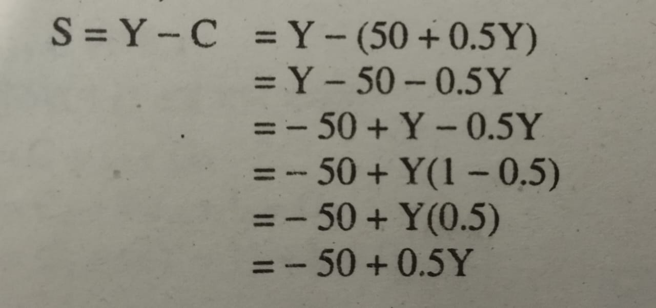
Mathematical problems on consumption function
  Find out the saving function.

Slide 19
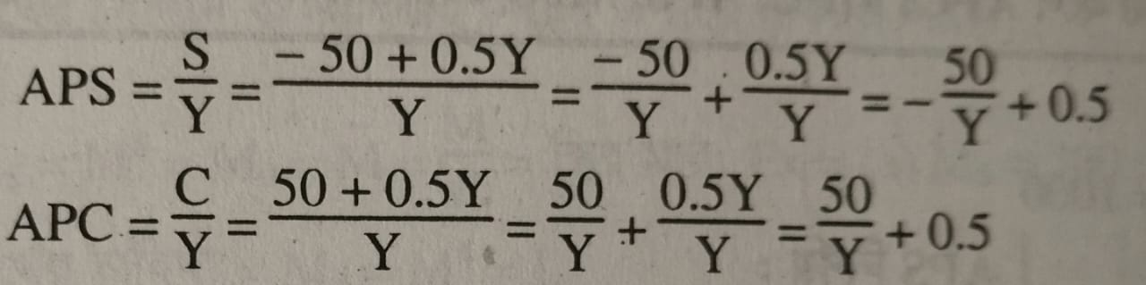
Mathematical problems on consumption function
  ii. APS+APC= 1

Slide 20
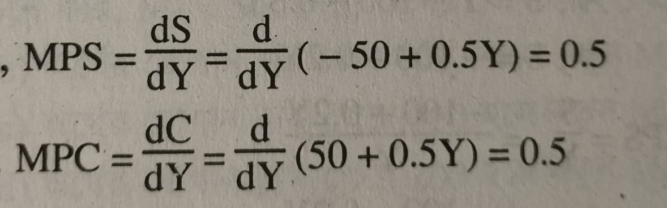
Mathematical problems on consumption function
  ii. MPS+MPC= 1

Slide 21
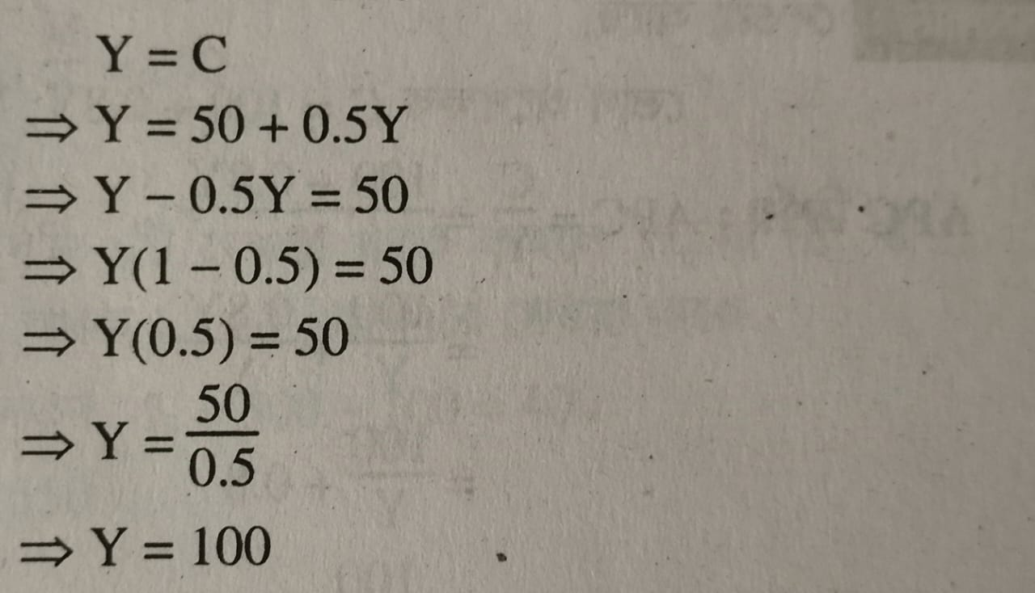
Mathematical problems on consumption function
  iv. Find out the breakeven point.

Slide 22
Mathematical problems on consumption function
2. Given as Savings function, S= -a + (1-b) Y
Find out consumption function.
Show that, APS+APC= 1
Show that, MPS+MPC=1
Find out the breakeven point.

Slide 23
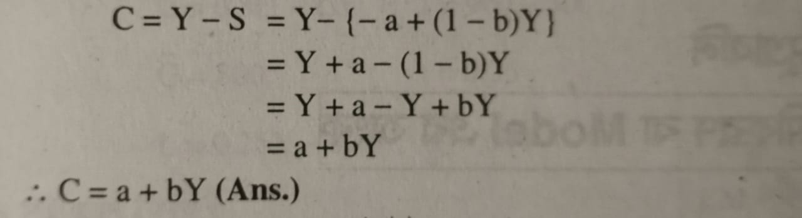
Mathematical problems on consumption function
  Find out the consumption function.

Slide 24
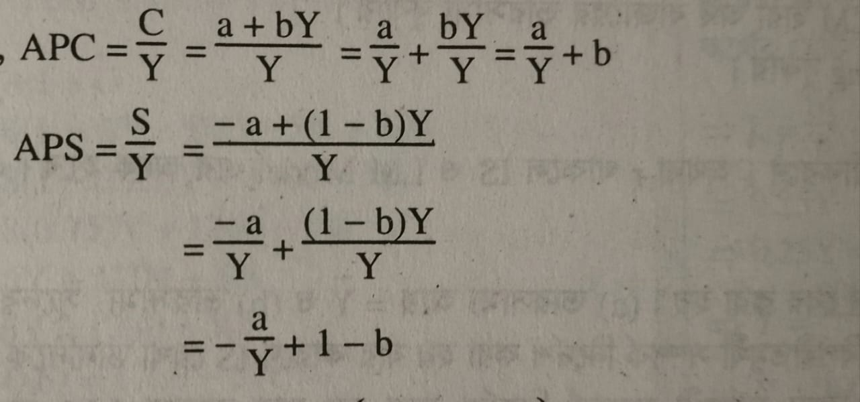
Mathematical problems on consumption function
  ii. APS+APC= 1

Slide 25
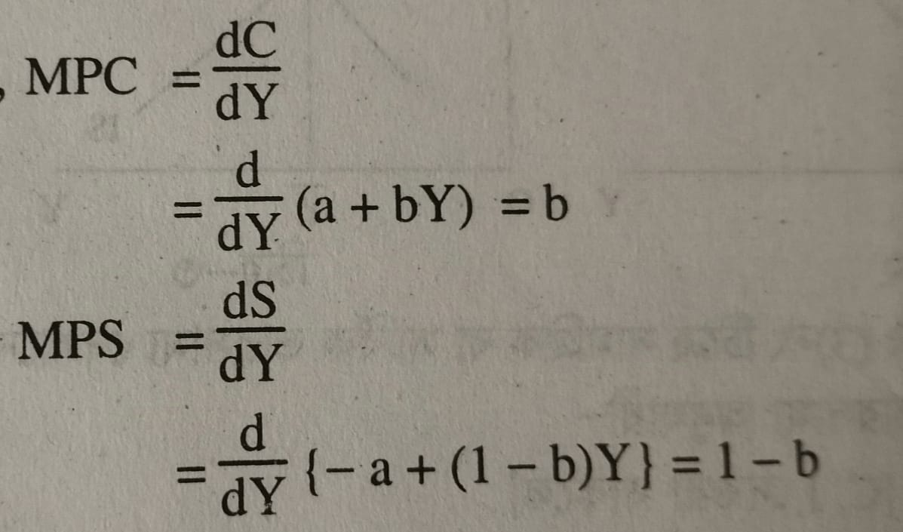
Mathematical problems on consumption function
  iii. MPS+MPC= 1

Slide 26
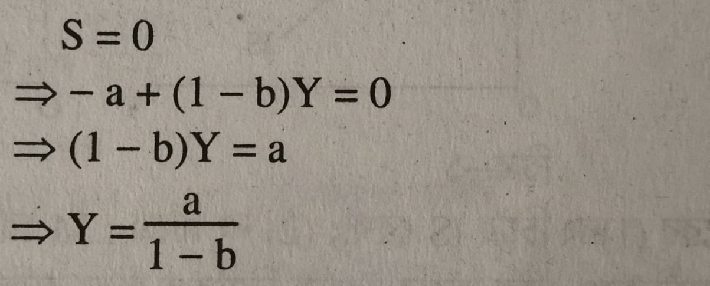
Mathematical problems on consumption function
  iv. Find out the breakeven point.

Slide 27
Mathematical problems on consumption function
2. Given as consumption function, C= 100 + 0.8 Y and Y= 1000
Find out APC, APS, MPC, MPS.

Slide 28
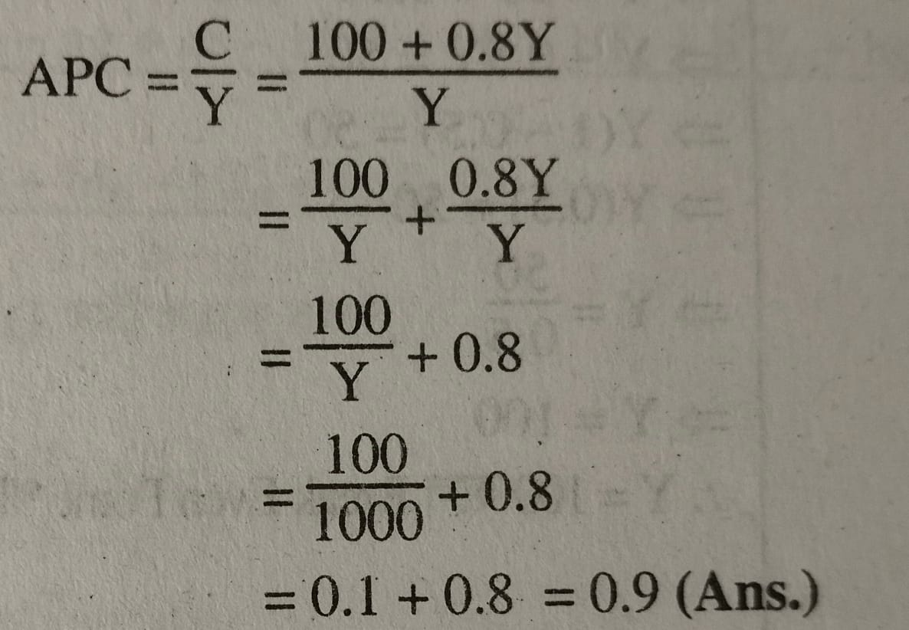
Mathematical problems on consumption function

Slide 29
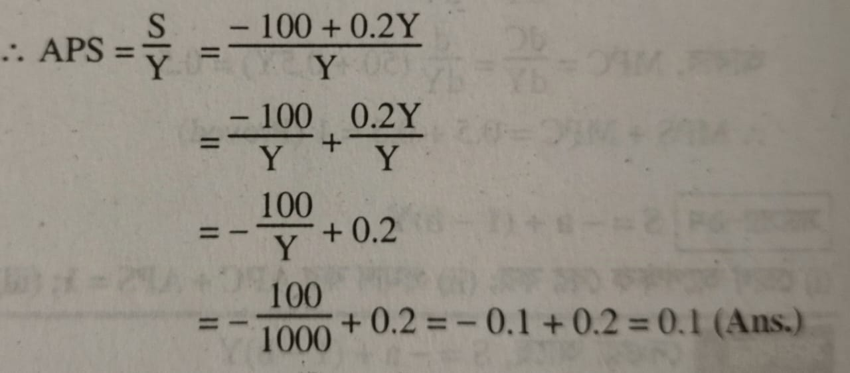
Mathematical problems on consumption function

Slide 30
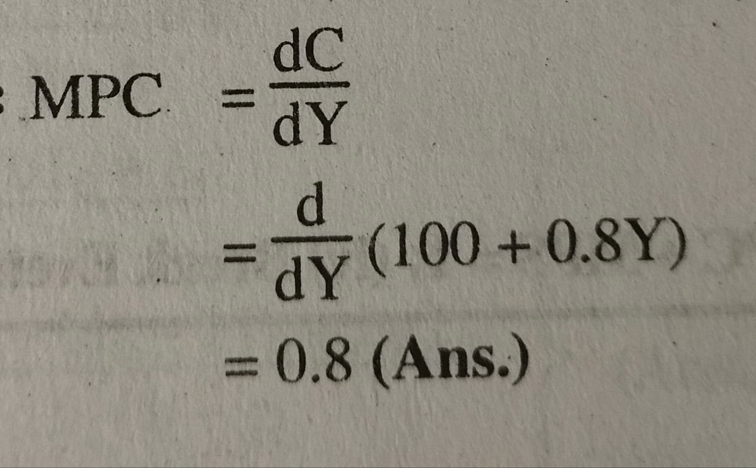
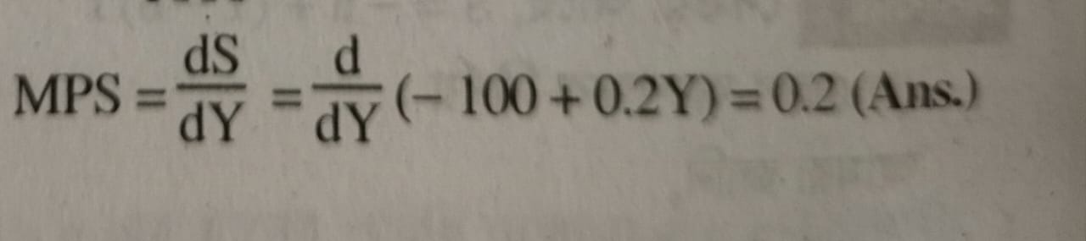
Mathematical problems on consumption function

